Slide 1
Unit One
Chapter 4
agenda
prospects
antidote
radical
apathy
reinforce
bland
relevant
propaganda
ruthless
Notes:
See page 20 in textbook.

Slide 2
Unit One / Chapter 4
Ten Words in Context
Notes:
See page 20 in textbook.

Slide 3
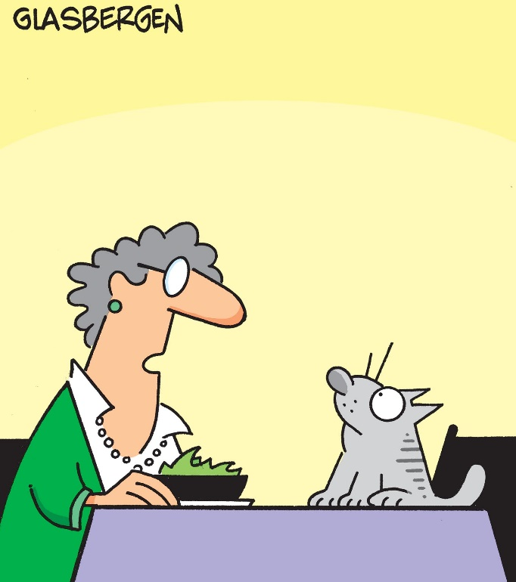
Unit One / Chapter 4
Ten Words in Context
1 agenda
– noun
There are two items on the agenda for today’s office meeting:
the company’s new product and the holiday party.
Ralph’s daily agenda includes driving his granddaughter to school, working at the soup kitchen, and walking his dog after dinner.
Choose the meaning closest
to that of the boldfaced word.
Agenda means
A. a schedule.
B. a desk.
C. a book.
Used with the permission of Randy Glasbergen
“Besides eating and sleeping,
what’s on your agenda for today?”
Notes:
See page 20 in textbook.
ANSWER: A
The next slide shows and explains the answer.

Slide 4
Unit One / Chapter 4
Ten Words in Context
1 agenda
– noun
There are two items on the agenda for today’s office meeting:
the company’s new product and the holiday party.
Ralph’s daily agenda includes driving his granddaughter to school, working at the soup kitchen, and walking his dog after dinner.
Agenda means
A. a schedule.
B. a desk.
C. a book.
Used with the permission of Randy Glasbergen
Two items are on the schedule for discussion at today’s meeting. Ralph’s daily schedule includes the three activities listed.
“Besides eating and sleeping,
what’s on your agenda for today?”
Notes:
See page 20 in textbook.

Slide 5
Unit One / Chapter 4
Ten Words in Context
2 antidote
– noun
Because there was no antidote for the snake’s poison, the cat that was bitten died.
For me, a good antidote to feeling low is to bake a batch of brownies.
Meditation is
a good antidote
to stress.
Antidote means
A. a short story.
B. a cause.
C. a cure.
Longtrekhome via Wikimedia Commons
Notes:
See page 20 in textbook.
ANSWER: C
The next slide shows and explains the answer.

Slide 6
Unit One / Chapter 4
Ten Words in Context
2 antidote
– noun
Because there was no antidote for the snake’s poison, the cat that was bitten died.
For me, a good antidote to feeling low is to bake a batch of brownies.
Meditation is
a good antidote
to stress.
Antidote means
A. a short story.
B. a cause.
C. a cure.
The cat died because there was no cure for the poison. Baking a batch
of brownies (and then eating them) could be a cure for feeling low.
Longtrekhome via Wikimedia Commons
Notes:
See page 20 in textbook.

Slide 7
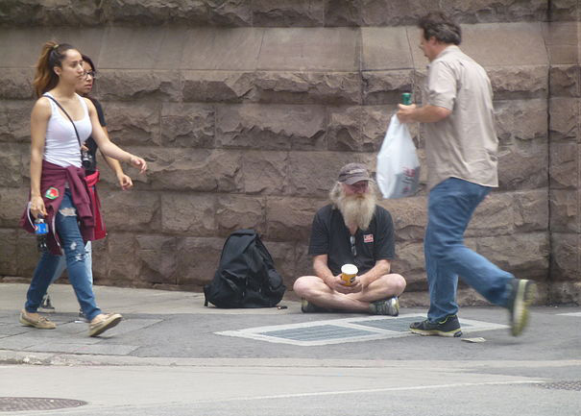
Unit One / Chapter 4
Ten Words in Context
3 apathy
– noun
Determined to shock her students out of their apathy, the history teacher showed up for class one day dressed as Joan of Arc.
Voter apathy was high, causing a low turnout on election day.
Apathy means
A. pity.
B. understanding.
C. lack of interest.
OldYorkGuy via Wikimedia Commons
Pedestrians responding with apathy
to a homeless man
Notes:
See page 20 in textbook.
ANSWER: C
The next slide shows and explains the answer.

Slide 8
Unit One / Chapter 4
Ten Words in Context
3 apathy
– noun
Determined to shock her students out of their apathy, the history teacher showed up for class one day dressed as Joan of Arc.
Voter apathy was high, causing a low turnout on election day.
Apathy means
A. pity.
B. understanding.
C. lack of interest.
The students might be shocked out
of their lack of interest if the teacher showed up for class dressed as
Joan of Arc. Low turnout on election day would indicate that the voters lacked interest.
OldYorkGuy via Wikimedia Commons
Pedestrians responding with apathy
to a homeless man
Notes:
See page 20 in textbook.

Slide 9
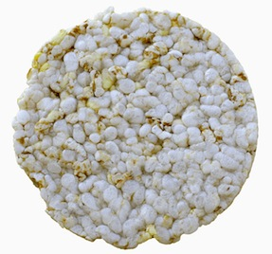
Unit One / Chapter 4
Ten Words in Context
4 bland
– adjective
The addition of a bright red scarf changed Linda’s gray outfit from bland to striking.
Bland means
A. old.
B. dull.
C. bitter.
© Stephen Gibson | Dreamstime.com
Many people think plain rice cakes
have a bland taste.
Notes:
See page 20 in textbook.
ANSWER: B
The next slide shows and explains the answer.

Slide 10
Unit One / Chapter 4
Ten Words in Context
4 bland
– adjective
The addition of a bright red scarf changed Linda’s gray outfit from bland to striking.
Mexicans, accustomed to hot and spicy foods, often find American dishes bland by comparison.
Bland means
A. old.
B. dull.
C. bitter.
The gray outfit by itself would seem dull; the bright red scarf would make the outfit striking. The hot and spicy foods make the less spicy American dishes seem dull by comparison.
© Stephen Gibson | Dreamstime.com
Many people think plain rice cakes
have a bland taste.
Notes:
See page 20 in textbook.

Slide 11
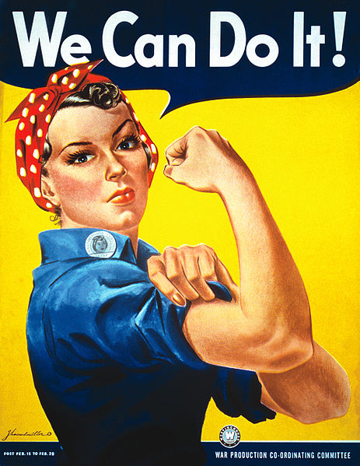
Unit One / Chapter 4
Ten Words in Context
5 propaganda
– noun
Until recently, the propaganda put out by cigarette companies said that nicotine didn’t harm people’s health.
The political candidates ran TV ads made up largely of propaganda directed against their opponents.
Propaganda means
A. research.
B. complaints.
C. publicity.
World War II
propaganda
to encourage
American workers
J. Howard Miller, the War Production Co-ordinating
Committee via Wikimedia Commons
Notes:
See page 20 in textbook.
ANSWER: C
The next slide shows and explains the answer.

Slide 12
Unit One / Chapter 4
Ten Words in Context
5 propaganda
– noun
Until recently, the propaganda put out by cigarette companies said that nicotine didn’t harm people’s health.
The political candidates ran TV ads made up largely of propaganda directed against their opponents.
Propaganda means
A. research.
B. complaints.
C. publicity.
World War II
propaganda
to encourage
American workers
In order to sell cigarettes, tobacco companies would put out publicity saying that nicotine
didn’t harm people’s health. Political candidates would put out publicity directed against their opponents. The words TV ads are a clue.
J. Howard Miller, the War Production Co-ordinating
Committee via Wikimedia Commons
Notes:
See page 20 in textbook.

Slide 13
Unit One / Chapter 4
Ten Words in Context
6 prospects
– noun
The movie’s prospects for doing well at the box office were harmed
by several bad reviews in the newspapers and on TV.
What are my prospects of finding a hotel room in this town during Super Bowl weekend?
Prospects means
A. reasons.
B. chances.
C. fears.
Notes:
See page 20 in textbook.
ANSWER: B
The next slide shows and explains the answer.

Slide 14
Unit One / Chapter 4
Ten Words in Context
6 prospects
– noun
The movie’s prospects for doing well at the box office were harmed
by several bad reviews in the newspapers and on TV.
What are my prospects of finding a hotel room in this town during Super Bowl weekend?
Prospects means
A. reasons.
B. chances.
C. fears.
Bad reviews would harm a movie’s chances for doing well at the box office. One would wonder about the chances of finding a hotel room in town on Super Bowl weekend.
Notes:
See page 20 in textbook.

Slide 15
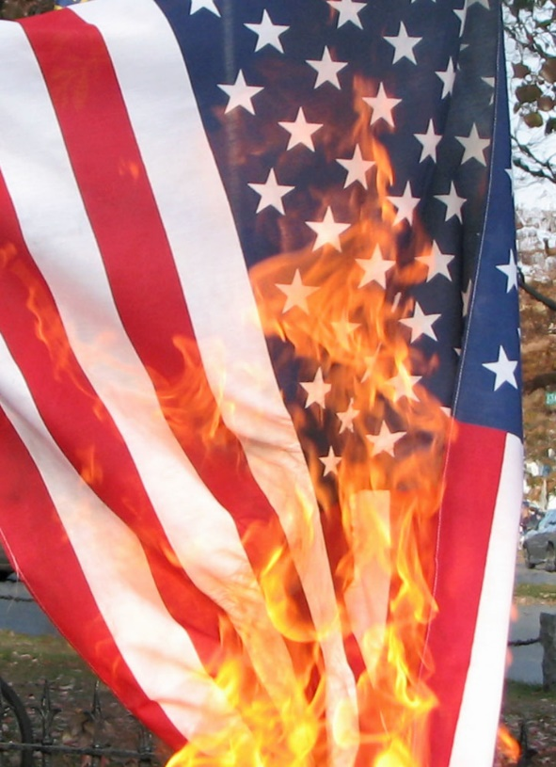
Unit One / Chapter 4
Ten Words in Context
7 radical
– adjective
I won’t vote for the radical candidate—his beliefs are too outrageous for me.
Most students tried to change school policy through peaceful compromise, but a radical group wanted to take over the president’s office by force.
Radical means
A. extreme.
B. average.
C. young.
Burning the flag
in protest is
a radical act.
Jennifer Parr via Wikimedia Commons
Notes:
See page 21 in textbook.
ANSWER: A
The next slide shows and explains the answer.

Slide 16
Unit One / Chapter 4
Ten Words in Context
7 radical
– adjective
I won’t vote for the radical candidate—his beliefs are too outrageous for me.
Most students tried to change school policy through peaceful compromise, but a radical group wanted to take over the president’s office by force.
Radical means
A. extreme.
B. average.
C. young.
Burning the flag
in protest is
a radical act.
In the first item, the word outrageous is a clue. In the second item, taking over the president’s office by force is an extreme way to try to change school policy.
Jennifer Parr via Wikimedia Commons
Notes:
See page 21 in textbook.

Slide 17
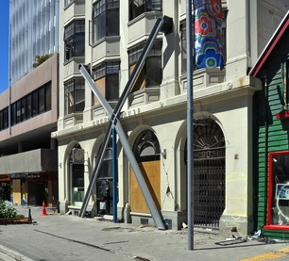
Unit One / Chapter 4
Ten Words in Context
8 reinforce
– verb
Seeing a poisonous snake cross his path reinforced Felipe’s belief that hiking in the woods is dangerous.
Some socks are reinforced at the heels and toes with extra layers of material so they won’t develop holes.
Reinforce means
A. to ruin.
B. to make stronger.
C. to repeat.
© Nigel Spiers | Dreamstime.com
The X-shaped braces
reinforce this building’s wall.
Notes:
See page 21 in textbook.
ANSWER: B
The next slide shows and explains the answer.

Slide 18
Unit One / Chapter 4
Ten Words in Context
8 reinforce
– verb
Seeing a poisonous snake cross his path reinforced Felipe’s belief that hiking in the woods is dangerous.
Some socks are reinforced at the heels and toes with extra layers of material so they won’t develop holes.
Reinforce means
A. to ruin.
B. to make stronger.
C. to repeat.
The sight of a poisonous snake would strengthen Felipe's belief that hiking in the woods is dangerous. Extra layers of material would make the heels and toes stronger.
© Nigel Spiers | Dreamstime.com
The X-shaped braces
reinforce this building’s wall.
Notes:
See page 21 in textbook.

Slide 19
Unit One / Chapter 4
Ten Words in Context
9 relevant
– adjective
History is always relevant to our lives because it shows us what results can follow certain actions.
“The weather is not relevant to this conversation,” Yvonne’s mother said. “Don’t change the subject when I bring up your speeding tickets.”
Relevant means
A. known.
B. related.
C. threatening.
Notes:
See page 21 in textbook.
ANSWER: B
The next slide shows and explains the answer.

Slide 20
Unit One / Chapter 4
Ten Words in Context
9 relevant
– adjective
History is always relevant to our lives because it shows us what results can follow certain actions.
“The weather is not relevant to this conversation,” Yvonne’s mother said. “Don’t change the subject when I bring up your speeding tickets.”
Relevant means
A. known.
B. related.
C. threatening.
By showing us what results can follow certain actions, history is related to our lives. The topic of the weather is not related to the topic of Yvonne’s speeding tickets.
Notes:
See page 21 in textbook.

Slide 21
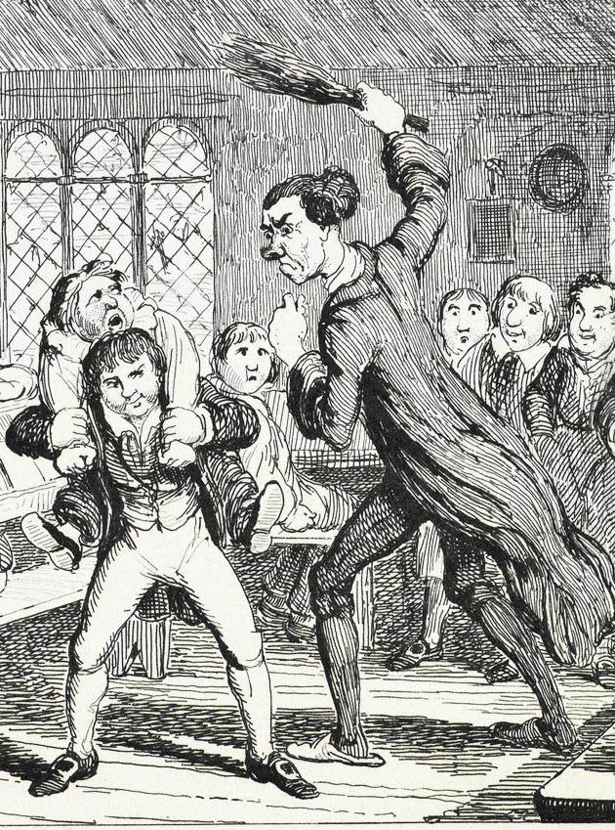
Unit One / Chapter 4
Ten Words in Context
10 ruthless
– adjective
My English teacher is a ruthless grader. He shows no mercy for weak reasoning or faulty grammar, so I’ve had to work extra hard on my papers.
Barry is so ruthless that he would step on coworkers to advance himself.
A ruthless
schoolmaster
punishing
a student
Ruthless means
A. sweet.
B. confusing.
C. without mercy.
Illustration by George Cruikshank (1839)
via Wikimedia Commons
Notes:
See page 21 in textbook.
ANSWER: C
The next slide shows and explains the answer.

Slide 22
Unit One / Chapter 4
Ten Words in Context
10 ruthless
– adjective
My English teacher is a ruthless grader. He shows no mercy for weak reasoning or faulty grammar, so I’ve had to work extra hard on my papers.
Barry is so ruthless that he would step on coworkers to advance himself.
A ruthless
schoolmaster
punishing
a student
Ruthless means
A. sweet.
B. confusing.
C. without mercy.
In the first item, the words shows no mercy
are a clue. In the second item, someone who would step on his coworkers to advance himself is a person who is without mercy.
Illustration by George Cruikshank (1839)
via Wikimedia Commons
Notes:
See page 21 in textbook.

