Slide 1
Unit One
Chapter 3
delete
menace
impartial
morale
integrity
naive
legitimate
overt
lenient
undermine
Notes:
See page 16 in textbook.

Slide 2
Unit One / Chapter 3
Ten Words in Context
Notes:
See page 16 in textbook.

Slide 3
Unit One / Chapter 3
Ten Words in Context
1 delete
– verb
When I accidentally deleted several paragraphs of my research paper from the computer, it took ten minutes to retype them.
The invitation list is too long. Unless we delete a few names, the party will be too crowded.
Choose the meaning closest
to that of the boldfaced word.
Delete means
A. to type.
B. to add.
C. to get rid of.
self-evident
We hold these truths to be obvious,
that all men are created equal . . .
The word obvious has been deleted and replaced with self-evident.
Notes:
See page 16 in textbook.
ANSWER: C
The next slide shows and explains the answer.

Slide 4
Unit One / Chapter 3
Ten Words in Context
1 delete
– verb
When I accidentally deleted several paragraphs of my research paper from the computer, it took ten minutes to retype them.
The invitation list is too long. Unless we delete a few names, the party will be too crowded.
Delete means
A. to type.
B. to add.
C. to get rid of.
self-evident
We hold these truths to be obvious,
that all men are created equal . . .
The word obvious has been deleted and replaced with self-evident.
If the writer had to retype the paragraphs, he or she must have accidentally gotten rid of them. If the
list is too long, it can be made shorter by getting rid of a few names.
Notes:
See page 16 in textbook.

Slide 5
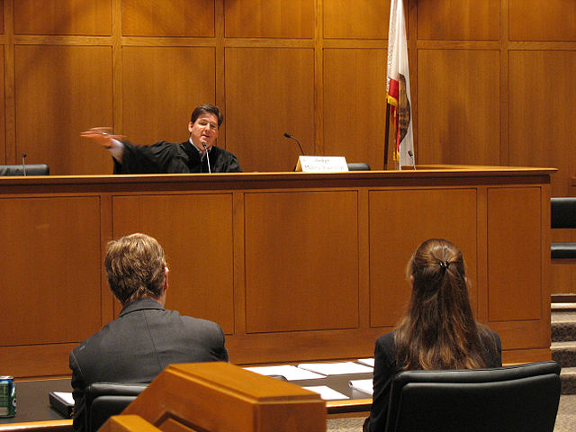
Unit One / Chapter 3
Ten Words in Context
2 impartial
– adjective
Too much publicity before a trial makes it difficult for lawyers to find impartial jurors, people with no opinion about the case.
“I’m an impartial judge of character,” Dolores joked. “I distrust all people equally, without prejudice.”
Impartial means
A. not whole.
B. fair.
C. friendly.
maveric2003 via Wikimedia Commons
A judge is expected to be impartial
in the courtroom.
Notes:
See page 16 in textbook.
ANSWER: B
The next slide shows and explains the answer.

Slide 6
Unit One / Chapter 3
Ten Words in Context
2 impartial
– adjective
Too much publicity before a trial makes it difficult for lawyers to find impartial jurors, people with no opinion about the case.
“I’m an impartial judge of character,” Dolores joked. “I distrust all people equally, without prejudice.”
Impartial means
A. not whole.
B. fair.
C. friendly.
People with no opinion about the case would be fair jurors. Someone who views all people without prejudice is
fair when judging a person’s character.
maveric2003 via Wikimedia Commons
A judge is expected to be impartial
in the courtroom.
Notes:
See page 16 in textbook.

Slide 7
Unit One / Chapter 3
Ten Words in Context
3 integrity
– noun
Our boss trusts Ramon with the key to the cash register because she knows that he has integrity.
“Have you no integrity?” Lauren asked her brother when she found out he had cheated in the marathon by taking the subway.
Integrity means
A. honesty.
B. talent.
C. a good memory.
Notes:
See page 16 in textbook.
ANSWER: A
The next slide shows and explains the answer.

Slide 8
Unit One / Chapter 3
Ten Words in Context
3 integrity
– noun
Our boss trusts Ramon with the key to the cash register because she knows that he has integrity.
“Have you no integrity?” Lauren asked her brother when she found out he had cheated in the marathon by taking the subway.
Integrity means
A. honesty.
B. talent.
C. a good memory.
If the boss trusts Ramon with the cash register key, she must know that he is honest. If the brother cheated in the marathon, then he was not being honest.
Notes:
See page 16 in textbook.

Slide 9
Unit One / Chapter 3
Ten Words in Context
4 legitimate
– adjective
Naomi gave her coach a doctor’s note to show she had a legitimate reason for missing the soccer game.
Any company that guarantees to make all investors millionaires can’t possibly be legitimate.
Legitimate means
A. safe.
B. legal.
C. healthy.
Notes:
See page 16 in textbook.
ANSWER: B
The next slide shows and explains the answer.

Slide 10
Unit One / Chapter 3
Ten Words in Context
4 legitimate
– adjective
Naomi gave her coach a doctor’s note to show she had a legitimate reason for missing the soccer game.
Any company that guarantees to make all investors millionaires can’t possibly be legitimate.
Legitimate means
A. safe.
B. legal.
C. healthy.
A doctor would be able to write a note giving a legal reason for missing a soccer game. A company that guarantees to make all investors millionaires must be doing things that are not legal.
Notes:
See page 16 in textbook.

Slide 11
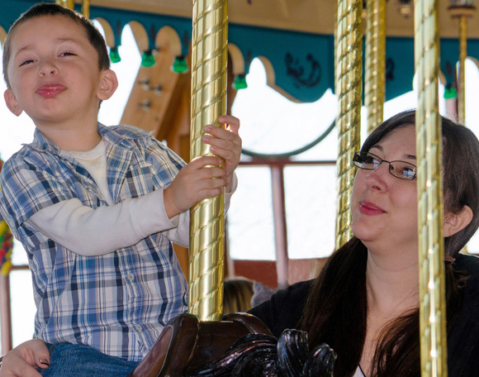
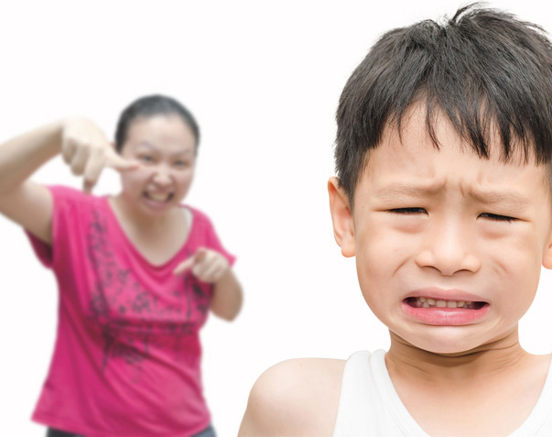
Unit One / Chapter 3
Ten Words in Context
5 lenient
– adjective
Ms. Hall is very lenient about late papers. If you hand one in even a week late, she doesn’t lower your grade.
Mom wouldn’t let us feed our poodle during dinner. But Dad, who was more lenient, would look the other way when we slipped the
dog something under the table.
Lenient means
A. heartless.
B. easygoing.
C. honest.
© Susan Sheldon | Dreamstime.com
© Parinyabinsuk | Dreamstime.com
A lenient mother
A NOT lenient mother
Notes:
See page 16 in textbook.
ANSWER: B
The next slide shows and explains the answer.

Slide 12
Unit One / Chapter 3
Ten Words in Context
5 lenient
– adjective
Ms. Hall is very lenient about late papers. If you hand one in even a week late, she doesn’t lower your grade.
Mom wouldn’t let us feed our poodle during dinner. But Dad, who was more lenient, would look the other way when we slipped the
dog something under the table.
Lenient means
A. heartless.
B. easygoing.
C. honest.
© Susan Sheldon | Dreamstime.com
A teacher who doesn’t lower your grade for handing a paper in a week late must be easygoing. If Dad looked the other way when the children fed the dog at the table, he was more easygoing than Mom.
© Parinyabinsuk | Dreamstime.com
A lenient mother
A NOT lenient mother
Notes:
See page 16 in textbook.

Slide 13
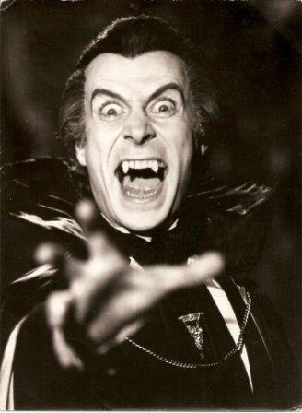
Unit One / Chapter 3
Ten Words in Context
6 menace
– noun
Acid rain is the biggest menace to the survival of freshwater fish.
Ron’s impatient attitude and his fast, zigzag driving make him a menace on the road.
Menace means
A. a puzzle.
B. something noticeable.
C. a danger.
Alejandro Lunadei via Wikimedia Commons
This creature is a menace to others.
Notes:
See page 16 in textbook.
ANSWER: C
The next slide shows and explains the answer.

Slide 14
Unit One / Chapter 3
Ten Words in Context
6 menace
– noun
Acid rain is the biggest menace to the survival of freshwater fish.
Ron’s impatient attitude and his fast, zigzag driving make him a menace on the road.
Menace means
A. a puzzle.
B. something noticeable.
C. a danger.
Because acid rain threatens the survival
of fresh water fish, it is a danger to them.
If Ron is impatient and drives erratically,
he is a danger on the road.
Alejandro Lunadei via Wikimedia Commons
This creature is a menace to others.
Notes:
See page 16 in textbook.

Slide 15
Unit One / Chapter 3
Ten Words in Context
7 morale
– noun
Art class was good for Tyrone’s morale. Each time the teacher praised his drawings, his confidence and enthusiasm increased.
The workers’ morale was so low that they constantly complained about the job. The only good part of the day was quitting time.
Morale means
A. spirit.
B. pay.
C. sense of right and wrong.
Used with the permission of Randy Glasbergen
“Does that really help boost your morale?”
Notes:
See page 17 in textbook.
ANSWER: A
The next slide shows and explains the answer.

Slide 16
Unit One / Chapter 3
Ten Words in Context
7 morale
– noun
Art class was good for Tyrone’s morale. Each time the teacher praised his drawings, his confidence and enthusiasm increased.
The workers’ morale was so low that they constantly complained about the job. The only good part of the day was quitting time.
Morale means
A. spirit.
B. pay.
C. sense of right and wrong.
Used with the permission of Randy Glasbergen
Being praised would be good for Tyrone’s spirit. If the workers constantly complain, their spirit
must be low.
“Does that really help boost your morale?”
Notes:
See page 17 in textbook.

Slide 17
Unit One / Chapter 3
Ten Words in Context
8 naive
– adjective
Though young, Rhoda is not naive. Being on her own for so long has made her streetwise.
Having had little experience with salespeople, my younger sister is so naive that she believes everything they tell her.
Naive means
A. lacking experience.
B. generous.
C. questioning.
Notes:
See page 17 in textbook.
ANSWER: A
The next slide shows and explains the answer.

Slide 18
Unit One / Chapter 3
Ten Words in Context
8 naive
– adjective
Though young, Rhoda is not naive. Being on her own for so long has made her streetwise.
Having had little experience with salespeople, my younger sister is so naive that she believes everything they tell her.
Naive means
A. lacking experience.
B. generous.
C. questioning.
If Rhoda has been on her own a long time and is streetwise, she is not lacking experience. Someone who believes everything salespeople say is lacking experience. The words little experience are a clue.
Notes:
See page 17 in textbook.

Slide 19
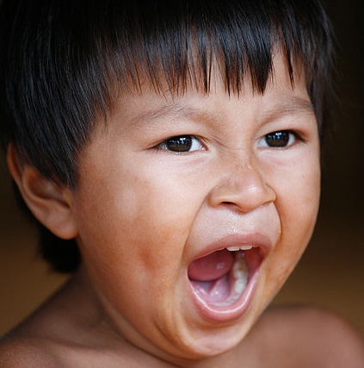
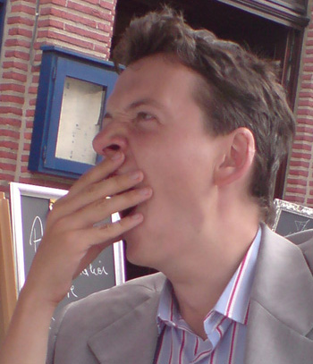
Unit One / Chapter 3
Ten Words in Context
9 overt
– adjective
Sometimes overt racism is easier to deal with than the hidden kind. You can better fight what is out in the open.
Maya’s love of reading was overt—books spilled over the shelves in every room of her apartment.
Overt means
A. obvious.
B. fair.
C. harmful.
Dmytro.Tchystiak via Wikimedia Commons
Alex Proimos via Wikimedia Commons
An overt yawn
A less overt yawn
Notes:
See page 17 in textbook.
ANSWER: A
The next slide shows and explains the answer.

Slide 20
Unit One / Chapter 3
Ten Words in Context
9 overt
– adjective
Sometimes overt racism is easier to deal with than the hidden kind. You can better fight what is out in the open.
Maya’s love of reading was overt—books spilled over the shelves in every room of her apartment.
Overt means
A. obvious.
B. fair.
C. harmful.
Dmytro.Tchystiak via Wikimedia Commons
Racism that is out in the open is obvious. If books spill over the shelves in every room, Maya’s love of reading is obvious.
Alex Proimos via Wikimedia Commons
An overt yawn
A less overt yawn
Notes:
See page 17 in textbook.

Slide 21
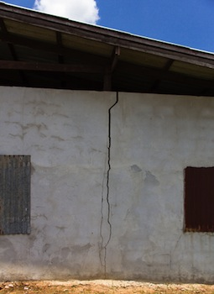
Unit One / Chapter 3
Ten Words in Context
10 undermine
– verb
Leroy tried to undermine the coach’s authority by making jokes about him behind his back.
Numerous floods had undermined the foundation so greatly that
the house was no longer safe.
Undermine means
A. to reach.
B. to explore.
C. to weaken.
Cracks undermine
the strength of this wall.
© Operationshooting88 | Dreamstime.com
Notes:
See page 17 in textbook.
ANSWER: C
The next slide shows and explains the answer.

Slide 22
Unit One / Chapter 3
Ten Words in Context
10 undermine
– verb
Leroy tried to undermine the coach’s authority by making jokes about him behind his back.
Numerous floods had undermined the foundation so greatly that
the house was no longer safe.
Undermine means
A. to reach.
B. to explore.
C. to weaken.
Cracks undermine
the strength of this wall.
Making jokes behind the coach’s back could weaken his authority. If the house
is no longer safe, the floods must have weakened the foundation.
© Operationshooting88 | Dreamstime.com
Notes:
See page 17 in textbook.

