Slide 1
BUILDING VOCABULARY
SKILLS
This presentation should be viewed in “Slide Show” view to display properly.
[Mac: Go to “Slide Show” pulldown menu and click on “Play from Start.”]
[PC: Go to “Slide Show” tab and click on “From beginning.”]
Use the tab key, space bar, arrow keys, or page up/down
to move through the slides.
These slides are optimized for PowerPoint versions 14 (2010/2011) and 16 (2015).
If viewed in earlier versions of PowerPoint, some slides may not display properly.

Slide 2
BUILDING VOCABULARY SKILLS
Fifth Edition
Eliza Comodromos
Paul Langan

Slide 3
Unit One
Chapter 2
dialogue
illuminate
erratic
isolate
extensive
refuge
forfeit
reminisce
fortify
urban
Notes:
See page 12 in textbook.

Slide 4
Unit One / Chapter 2
Ten Words in Context
Notes:
See page 12 in textbook.

Slide 5
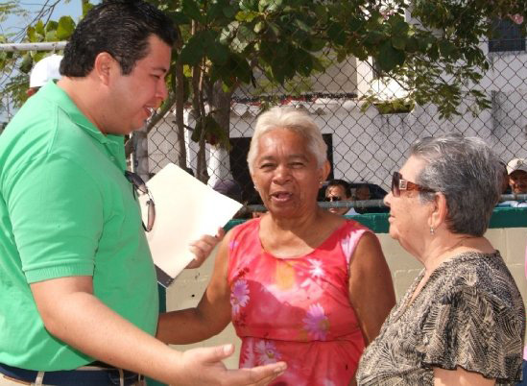
Unit One / Chapter 2
Ten Words in Context
1 dialog
– noun
The movie was shown with English subtitles because all its dialogue was in French.
At the PTA meeting last night, a dialogue between parents and the faculty helped to clear up some differences between them.
Choose the meaning closest
to that of the boldfaced word.
Dialogue means
A. a title.
B. a talk.
C. an action.
Genaroperezcamara via Wikimedia Commons
Neighbors having a dialogue
Notes:
See page 12 in textbook.
ANSWER: B
The next slide shows and explains the answer.

Slide 6
Unit One / Chapter 2
Ten Words in Context
1 dialog
– noun
The movie was shown with English subtitles because all its dialogue was in French.
At the PTA meeting last night, a dialogue between parents and the faculty helped to clear up some differences between them.
Dialogue means
A. a title.
B. a talk.
C. an action.
Genaroperezcamara via Wikimedia Commons
If the film had English subtitles, it must have been because all of the talking
was in French. The parents and faculty could help clear up differences by
talking at the PTA meeting.
Neighbors having a dialogue
Notes:
See page 12 in textbook.

Slide 7
Unit One / Chapter 2
Ten Words in Context
2 erratic
– adjective
Children’s eating habits are erratic. One day they’ll barely eat, and the next day they’ll eat enough for three.
The driver ahead of me was erratic—he kept changing his speed and his lane.
Erratic means
A. noisy.
B. healthy.
C. irregular.
Notes:
See page 12 in textbook.
ANSWER: C
The next slide shows and explains the answer.

Slide 8
Unit One / Chapter 2
Ten Words in Context
2 erratic
– adjective
Children’s eating habits are erratic. One day they’ll barely eat, and the next day they’ll eat enough for three.
The driver ahead of me was erratic—he kept changing his speed and his lane.
Erratic means
A. noisy.
B. healthy.
C. irregular.
If children barely eat one day and eat enough for three the next day, their eating habits are irregular. If the driver keeps changing his speed and his lane, his driving is irregular.
Notes:
See page 12 in textbook.

Slide 9
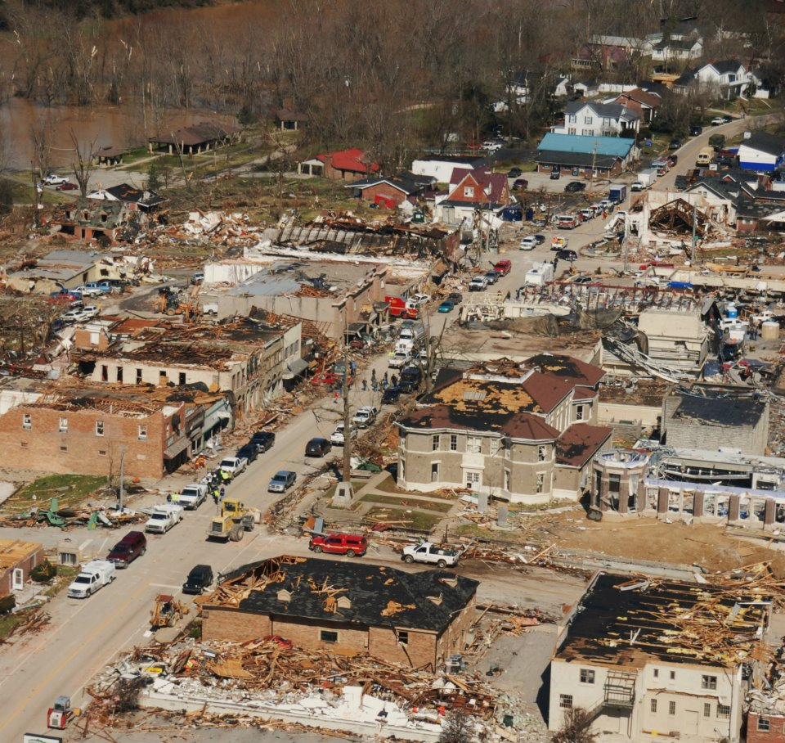
Unit One / Chapter 2
Ten Words in Context
3 extensive
– adjective
Selena did extensive research for her paper—it took her several weeks.
To save the wounded police officer, doctors performed extensive surgery that lasted for hours.
Extensive means
A. done quickly.
B. risky.
C. large in amount.
NWS Jackson, KY, NOAA, Allen Bolling via Wikimedia Commons
Extensive damage from a tornado
Notes:
See page 12 in textbook.
ANSWER: C
The next slide shows and explains the answer.

Slide 10
Unit One / Chapter 2
Ten Words in Context
3 extensive
– adjective
Selena did extensive research for her paper—it took her several weeks.
To save the wounded police officer, doctors performed extensive surgery that lasted for hours.
Extensive means
A. done quickly.
B. risky.
C. large in amount.
NWS Jackson, KY, NOAA, Allen Bolling via Wikimedia Commons
If Selena spent several weeks doing research, she must have done a large amount of research. If the surgery
lasted for several hours, it must
have been a large amount of surgery.
Extensive damage from a tornado
Notes:
See page 12 in textbook.

Slide 11
Unit One / Chapter 2
Ten Words in Context
4 forfeit
– verb
The basketball players were upset when the team bus broke down and they had to forfeit an important game.
If Phil gets into one more accident, he will forfeit the right to drive his parents’ car.
Forfeit means
A. to give up.
B. to win.
C. to ignore.
Notes:
See page 12 in textbook.
ANSWER: A
The next slide shows and explains the answer.

Slide 12
Unit One / Chapter 2
Ten Words in Context
4 forfeit
– verb
The basketball players were upset when the team bus broke down and they had to forfeit an important game.
If Phil gets into one more accident, he will forfeit the right to drive his parents’ car.
Forfeit means
A. to give up.
B. to win.
C. to ignore.
The basketball players would be upset if they had to give up an important game. Phil will have to give up his right to drive his parents’ car if he smashes it up one more time.
Notes:
See page 12 in textbook.

Slide 13
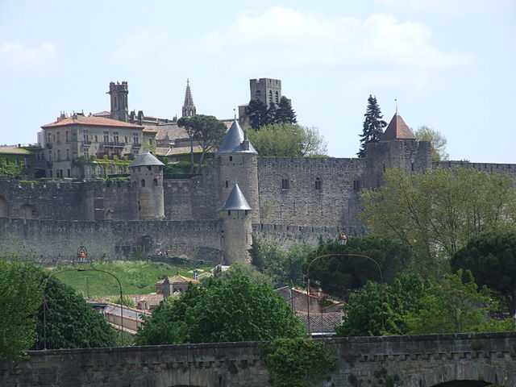
Unit One / Chapter 2
Ten Words in Context
5 fortify
– verb
The night before running a marathon, Elsa fortifies herself by eating a large plate of pasta.
The builders plan to fortify the old tower with steel beams.
Fortify means
A. to relax.
B. to strengthen.
C. to prove.
XFalkx via Wikimedia Commons
A town fortified with walls and towers
Notes:
See page 12 in textbook.
ANSWER: B
The next slide shows and explains the answer.

Slide 14
Unit One / Chapter 2
Ten Words in Context
5 fortify
– verb
The night before running a marathon, Elsa fortifies herself by eating a large plate of pasta.
The builders plan to fortify the old tower with steel beams.
Fortify means
A. to relax.
B. to strengthen.
C. to prove.
Eating a large plate of pasta would strengthen Elsa for the marathon. Putting steel beams in the old tower would strengthen it.
XFalkx via Wikimedia Commons
A town fortified with walls and towers
Notes:
See page 12 in textbook.

Slide 15
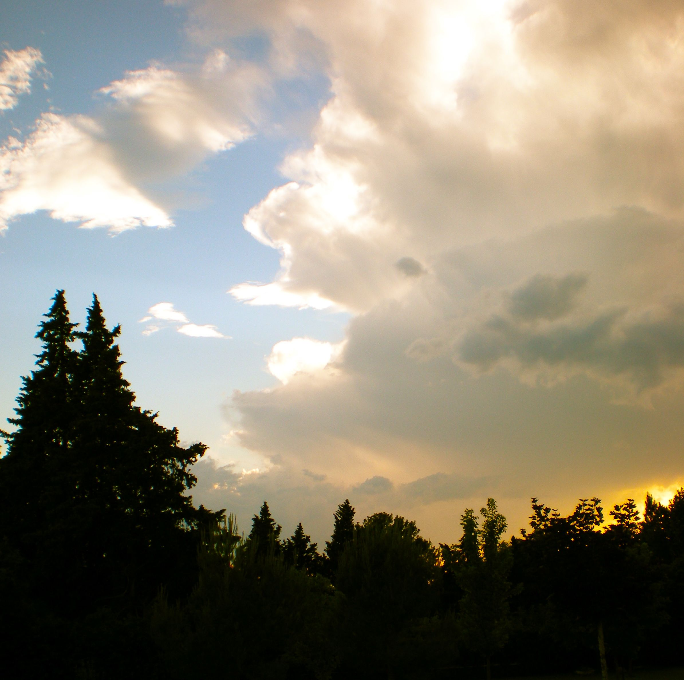
Unit One / Chapter 2
Ten Words in Context
6 illuminate
– verb
Before electricity, streets were illuminated by gaslight.
As soon as the morning sun illuminated the horizon, the vampire screamed and burst into flames.
Illuminate means
A. to lose.
B. to clean.
C. to light.
© Townsend Press
Clouds illuminated by the setting sun
Notes:
See page 12 in textbook.
ANSWER: C
The next slide shows and explains the answer.

Slide 16
Unit One / Chapter 2
Ten Words in Context
6 illuminate
– verb
Before electricity, streets were illuminated by gaslight.
As soon as the morning sun illuminated the horizon, the vampire screamed and burst into flames.
Illuminate means
A. to lose.
B. to clean.
C. to light.
Gaslight was used to light the streets. In the morning, the sun lights up the horizon.
© Townsend Press
Clouds illuminated by the setting sun
Notes:
See page 12 in textbook.

Slide 17
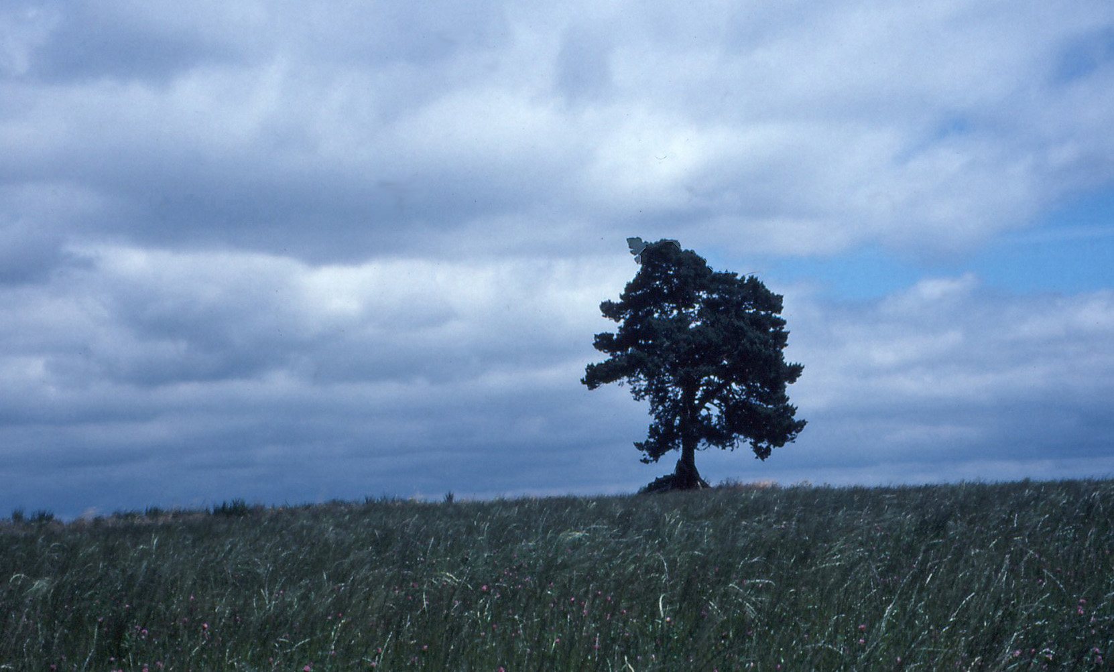
Unit One / Chapter 2
Ten Words in Context
7 isolate
– verb
I thought I would enjoy isolating myself at the vacation cabin, but I soon felt lonely.
Freddy was such a troublemaker that the teacher put his desk in a far corner to isolate him from the other students.
Isolate means
A. to protect.
B. to separate.
C. to recognize.
© Townsend Press
An isolated tree
Notes:
See page 13 in textbook.
ANSWER: B
The next slide shows and explains the answer.

Slide 18
Unit One / Chapter 2
Ten Words in Context
7 isolate
– verb
I thought I would enjoy isolating myself at the vacation cabin, but I soon felt lonely.
Freddy was such a troublemaker that the teacher put his desk in a far corner to isolate him from the other students.
Isolate means
A. to protect.
B. to separate.
C. to recognize.
If the person felt lonely at the
vacation cabin, he or she must
have been separated from others. Putting Freddy’s desk in a far
corner would separate him from
the other students.
© Townsend Press
An isolated tree
Notes:
See page 13 in textbook.

Slide 19
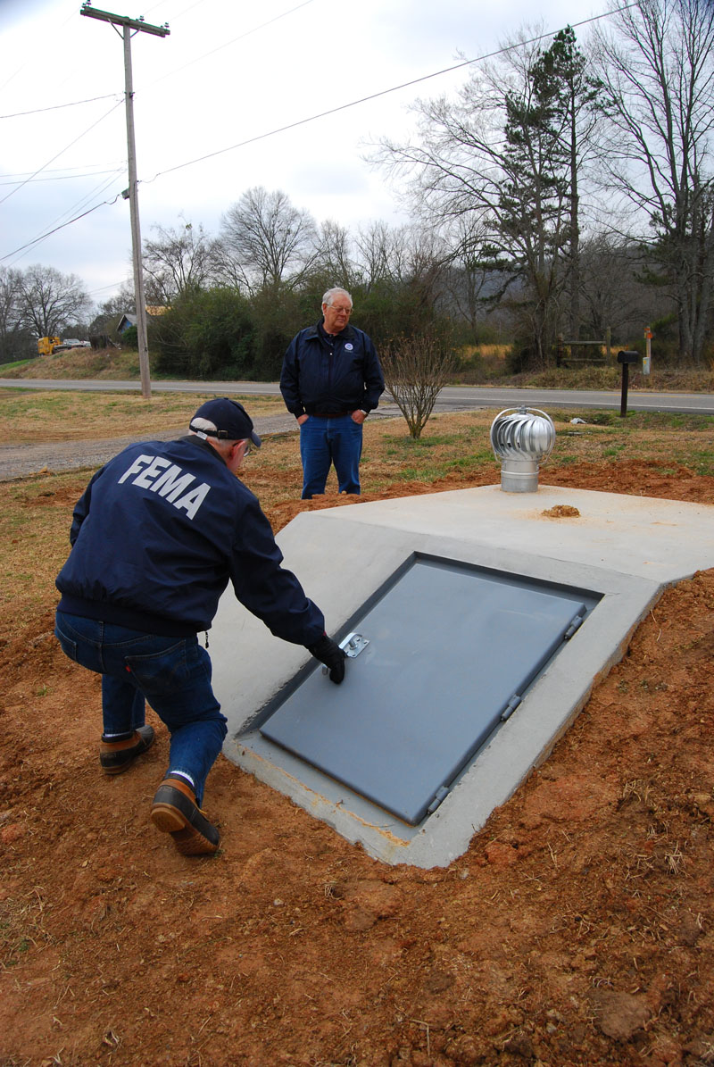
Unit One / Chapter 2
Ten Words in Context
8 refuge
– noun
A motorcycle offers no refuge in bad weather. If you have to ride in the rain, you’ll get soaked.
My boyfriend and I first met when we took refuge in the same doorway during a sudden rain.
An underground
refuge for safety
when a tornado strikes
Refuge means
A. a shelter.
B. transportation.
C. a reason.
Charles Powell via Wikimedia Commons
Notes:
See page 13 in textbook.
ANSWER: A
The next slide shows and explains the answer.

Slide 20
Unit One / Chapter 2
Ten Words in Context
8 refuge
– noun
A motorcycle offers no refuge in bad weather. If you have to ride in the rain, you’ll get soaked.
My boyfriend and I first met when we took refuge in the same doorway during a sudden rain.
An underground
refuge for safety
when a tornado strikes
Refuge means
A. a shelter.
B. transportation.
C. a reason.
If you have no shelter from bad weather, you’ll get soaked when it rains. If the woman and the boyfriend were caught
in the rain, they would take shelter in a doorway.
Charles Powell via Wikimedia Commons
Notes:
See page 13 in textbook.

Slide 21
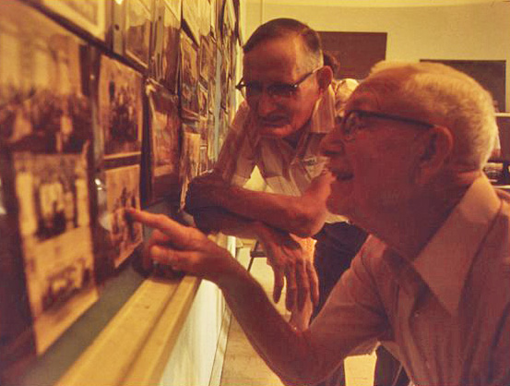
Unit One / Chapter 2
Ten Words in Context
9 reminisce
– verb
On their wedding anniversary, Lenny and Jean like to reminisce about their first date.
My father showed me his trophy and reminisced about his years as a star basketball player.
Reminisce means
A. to remember.
B. to forget.
C. to ask.
U.S. National Archives and Records via Wikimedia Commons
Two lifelong friends reminiscing
about their younger days
Notes:
See page 13 in textbook.
ANSWER: A
The next slide shows and explains the answer.

Slide 22
Unit One / Chapter 2
Ten Words in Context
9 reminisce
– verb
On their wedding anniversary, Lenny and Jean like to reminisce about their first date.
My father showed me his trophy and reminisced about his years as a star basketball player.
Reminisce means
A. to remember.
B. to forget.
C. to ask.
U.S. National Archives and Records via Wikimedia Commons
If it is their wedding anniversary, Lenny and Jean would be remembering their first date. The father won the trophy in the past, so he would be remembering the years when he was a star basketball player.
Two lifelong friends reminiscing
about their younger days
Notes:
See page 13 in textbook.

Slide 23
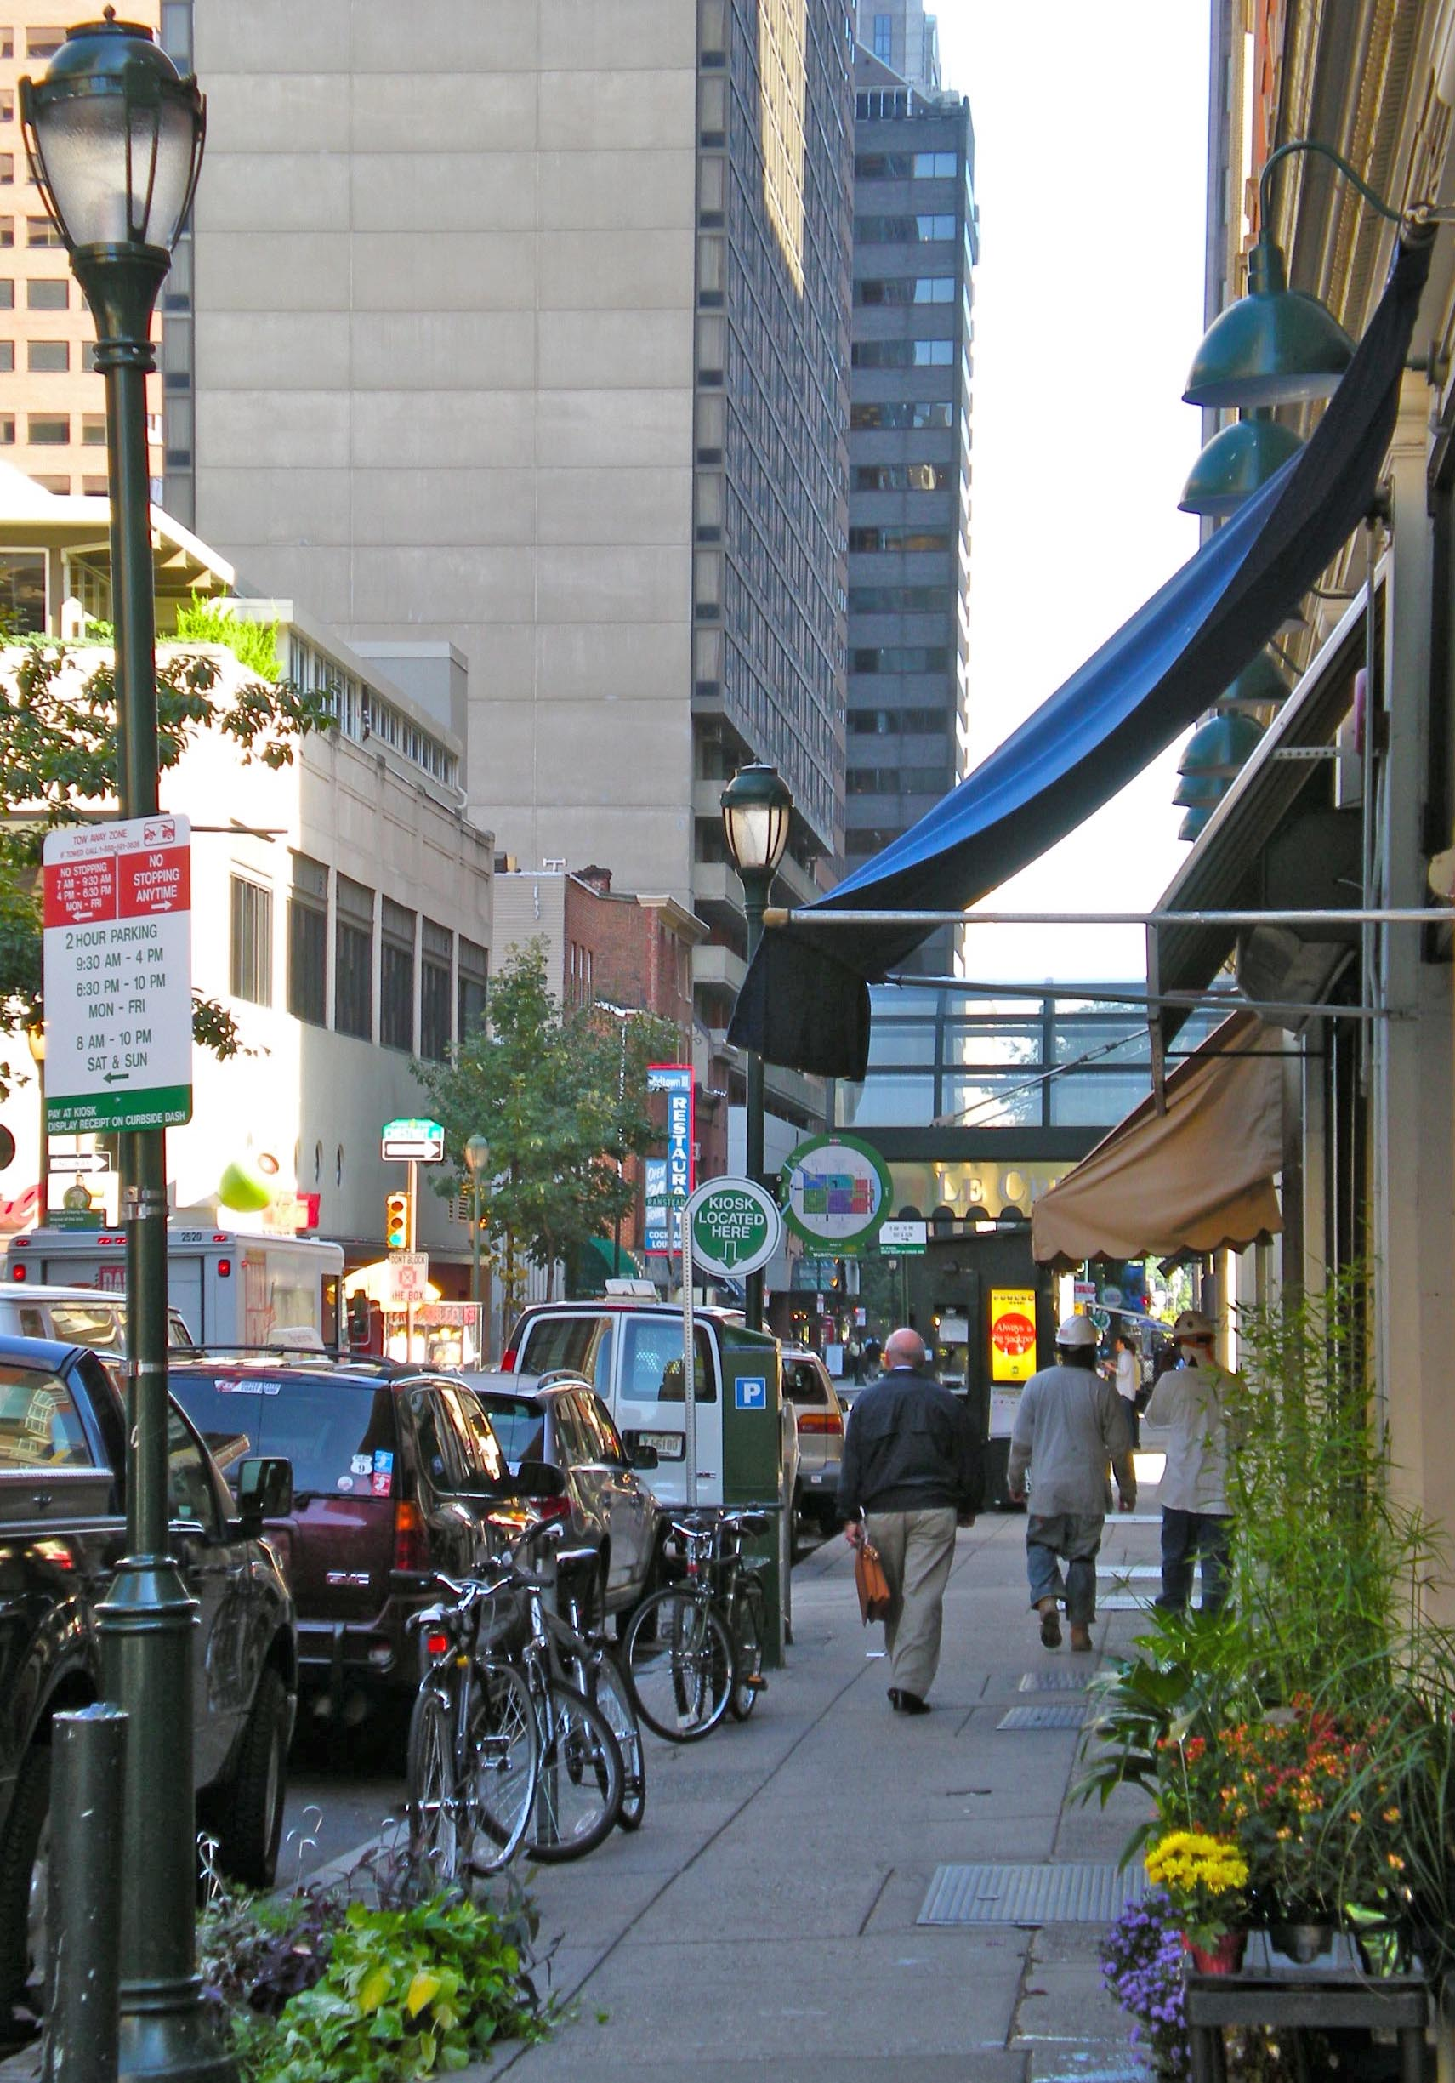
Unit One / Chapter 2
Ten Words in Context
10 urban
– adjective
Skyscrapers make for tightly packed urban populations. For example, some 25,000 people visit the Willis Tower in Chicago every day.
Gladys likes urban living because she grew up in the city, but Emilio, who grew up on a farm, prefers country life.
Urban means
A. country.
B. city.
C. national.
An urban street
© Townsend Press
Notes:
See page 13 in textbook.
ANSWER: B
The next slide shows and explains the answer.

Slide 24
Unit One / Chapter 2
Ten Words in Context
10 urban
– adjective
Skyscrapers make for tightly packed urban populations. For example, some 25,000 people visit the Willis Tower in Chicago every day.
Gladys likes urban living because she grew up in the city, but Emilio, who grew up on a farm, prefers country life.
Urban means
A. country.
B. city.
C. national.
An urban street
Skyscrapers are built in cities. In the second sentence, city living is contrasted with
country life.
© Townsend Press
Notes:
See page 13 in textbook.

